Slide 1
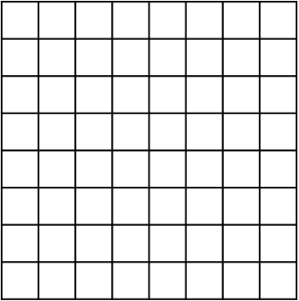
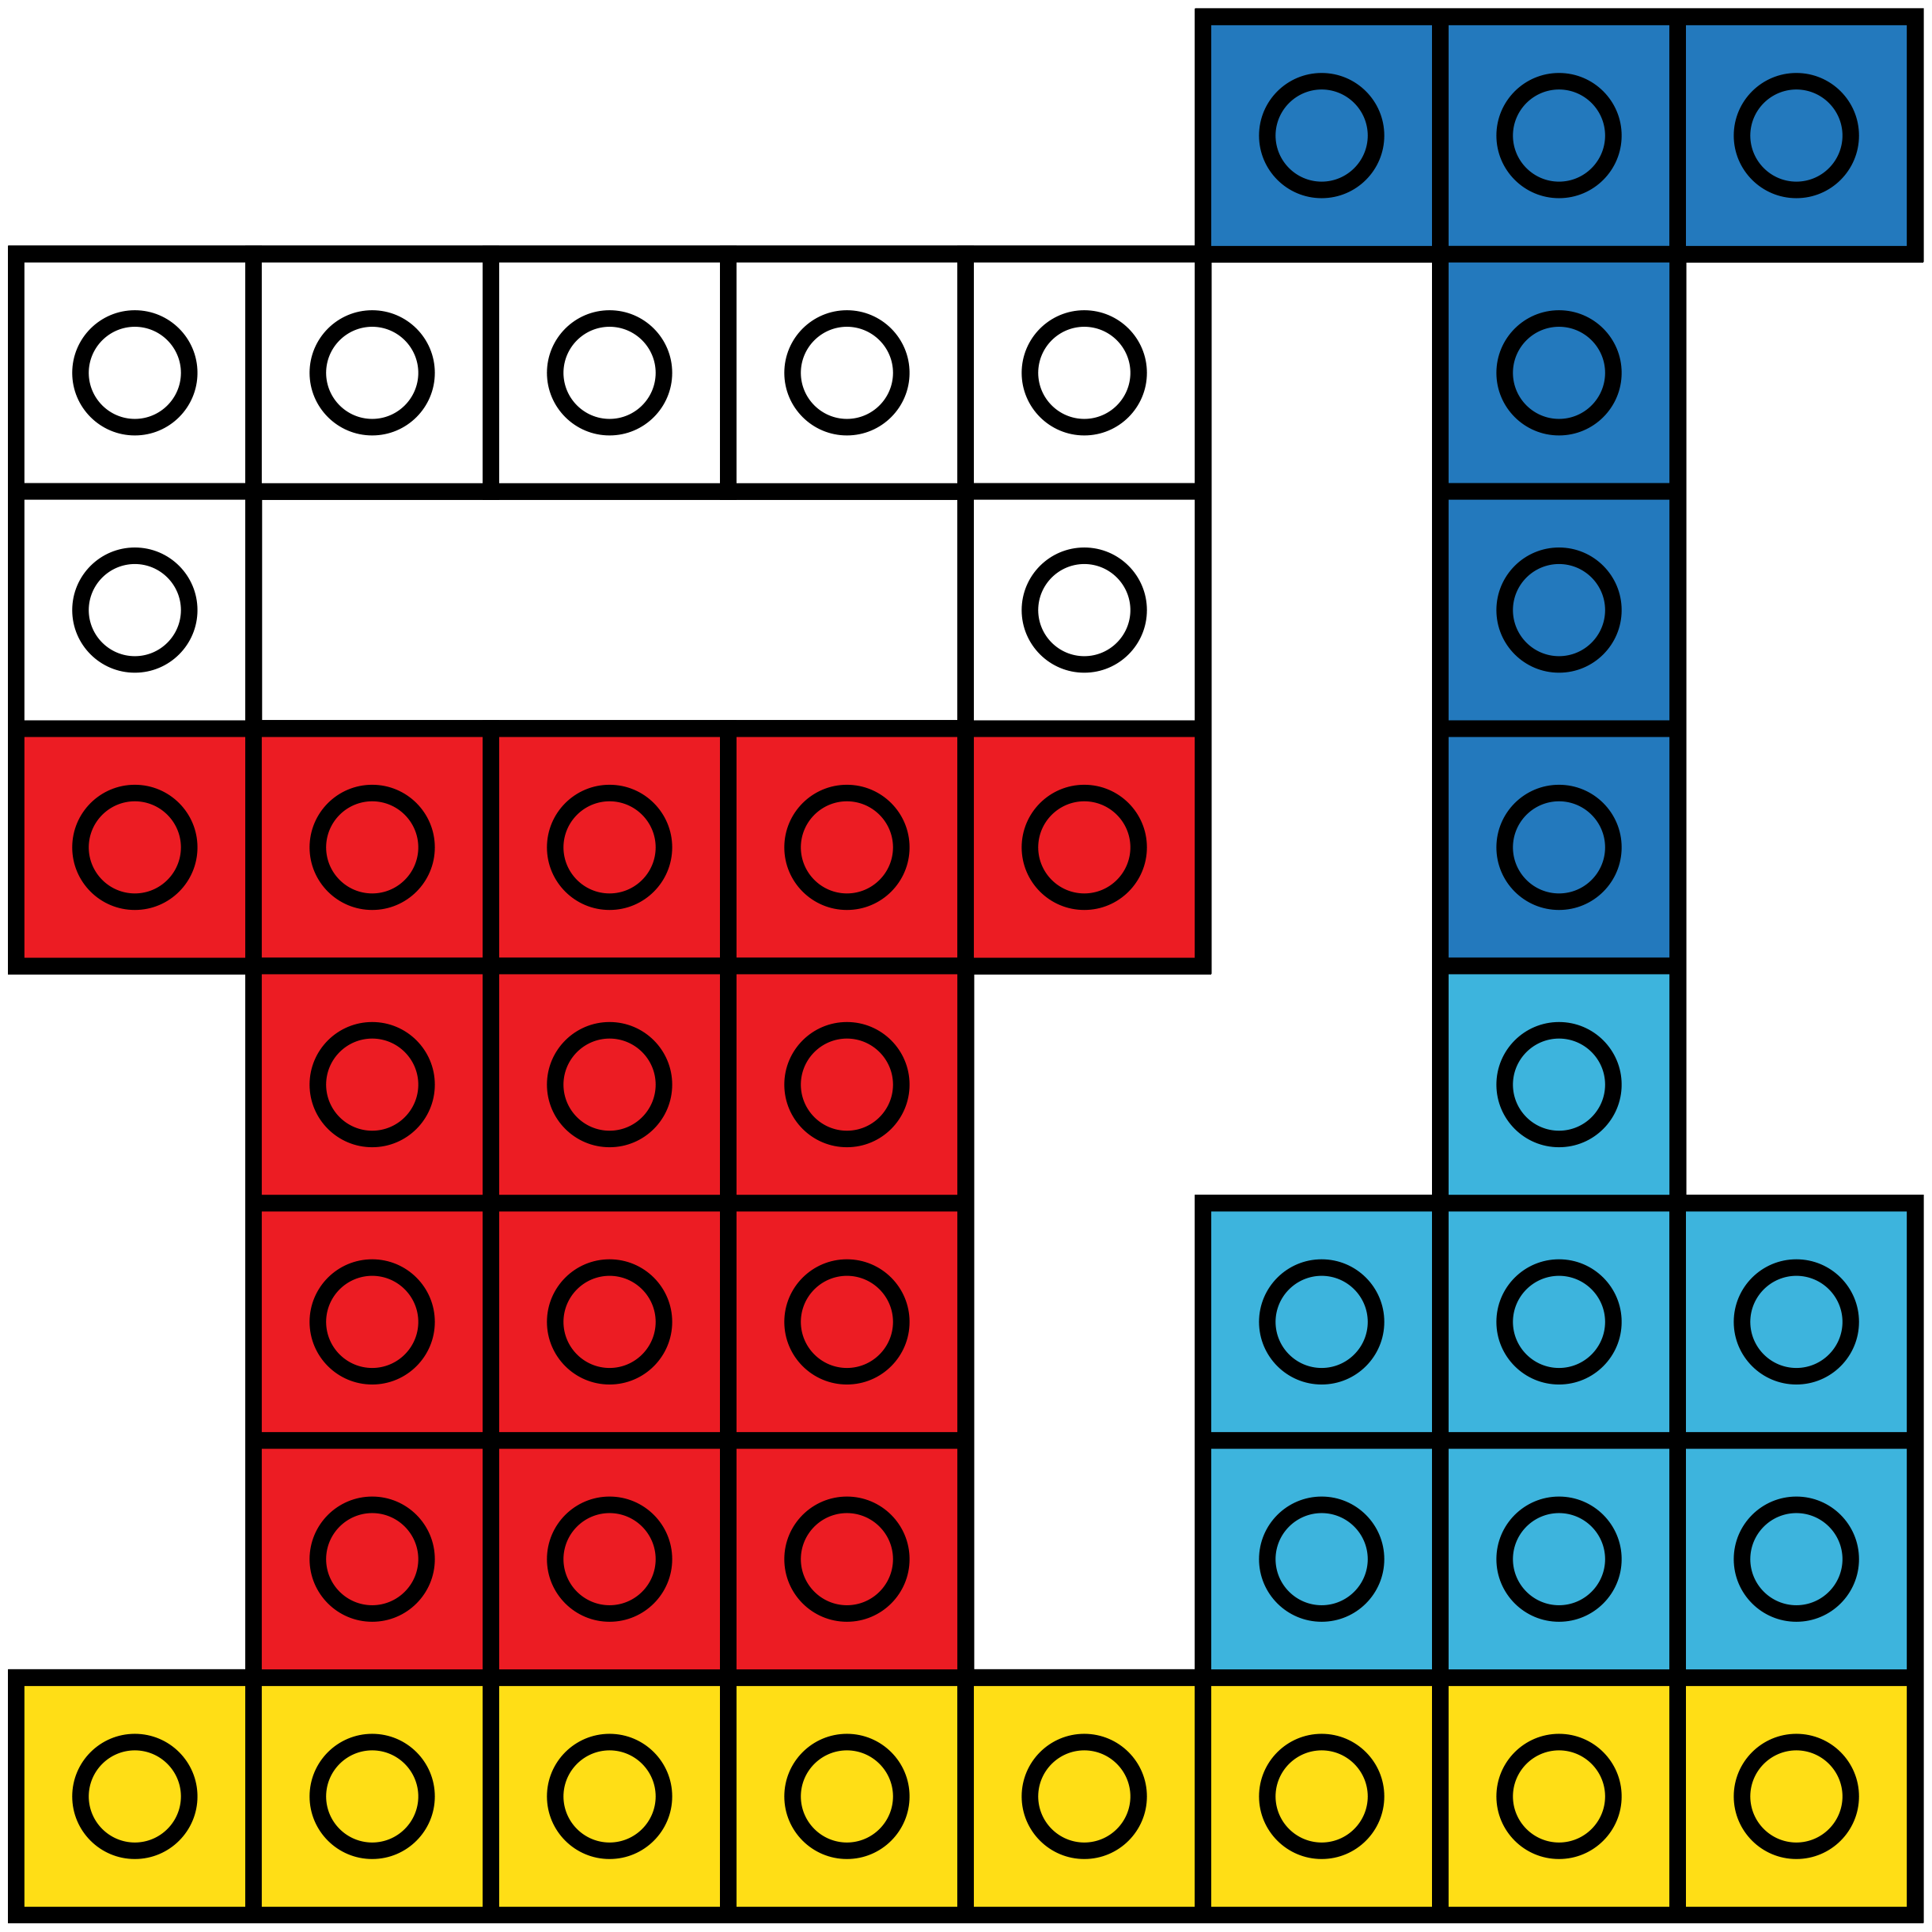
DIRECTIONS
On the following slides your job is to create the design by filling in the grid.
Each grid is 8x8, which means there are 8 rows and 8 columns.
You will click and drag the snap cube pieces to their places on the grid.
You can copy and paste this grid over the design on each slide if it helps you.
*Match the grid up to one corner of the design so that it fits.
This helps me to see where the blank boxes are on the grid. It is optional.
If you don’t want the grid. Click on it and then press the Del key.
GRID
NO GRID

Slide 2
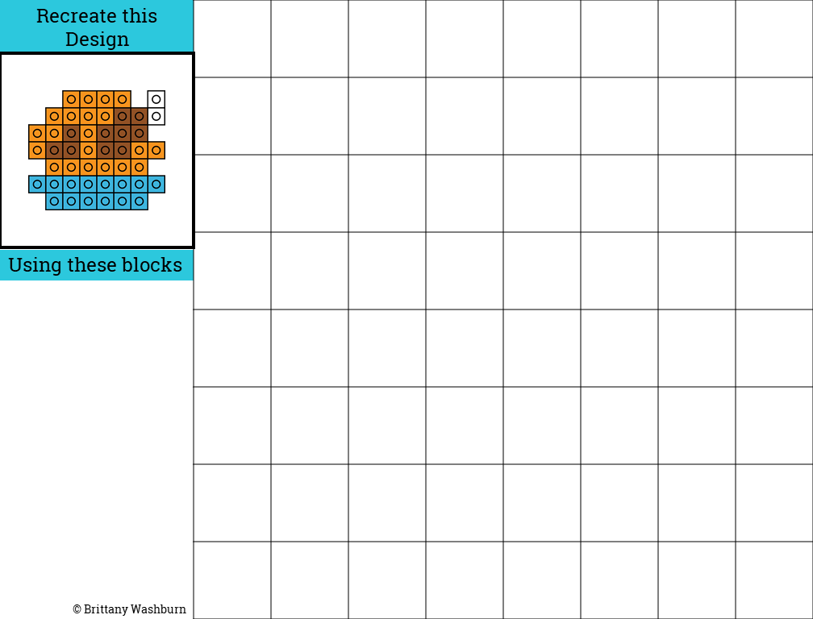

Slide 3
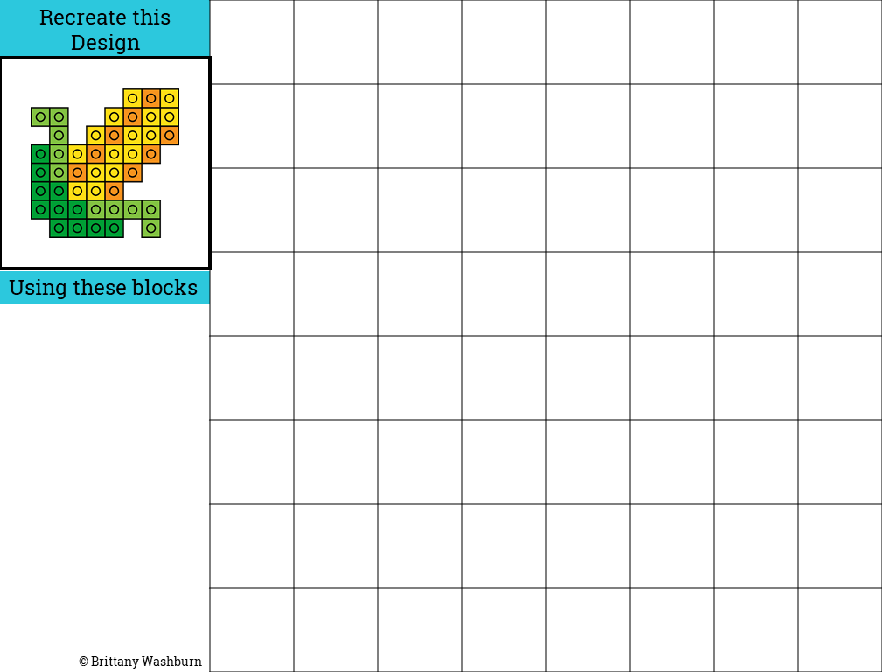

Slide 4
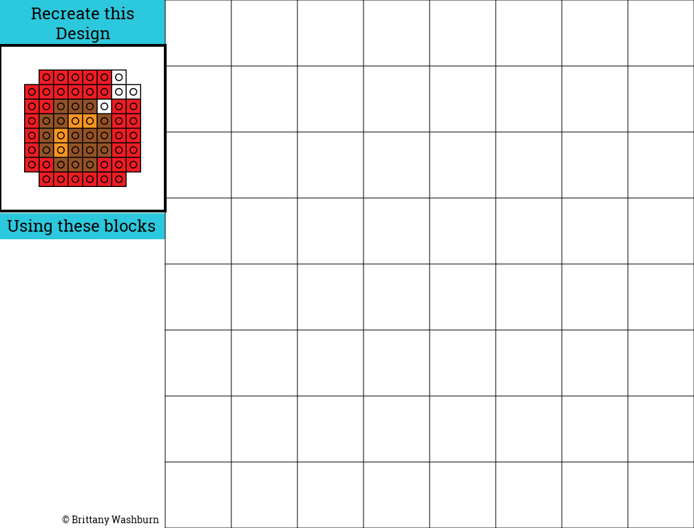

Slide 5
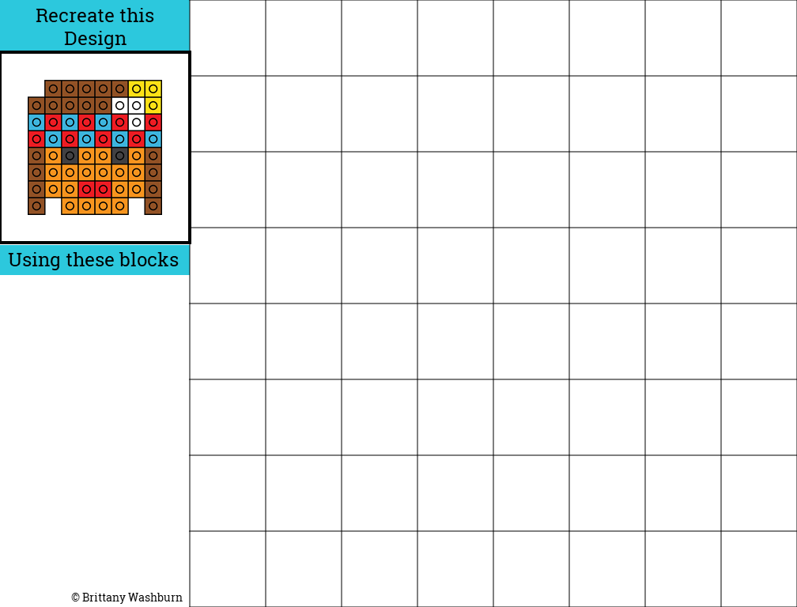

Slide 7
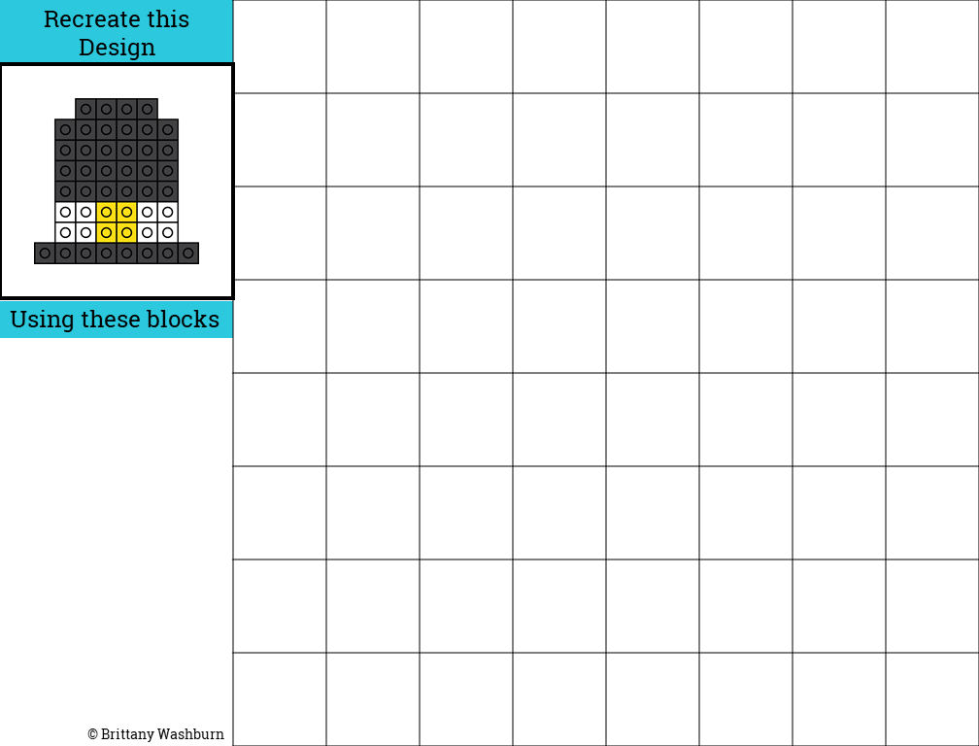

Slide 8
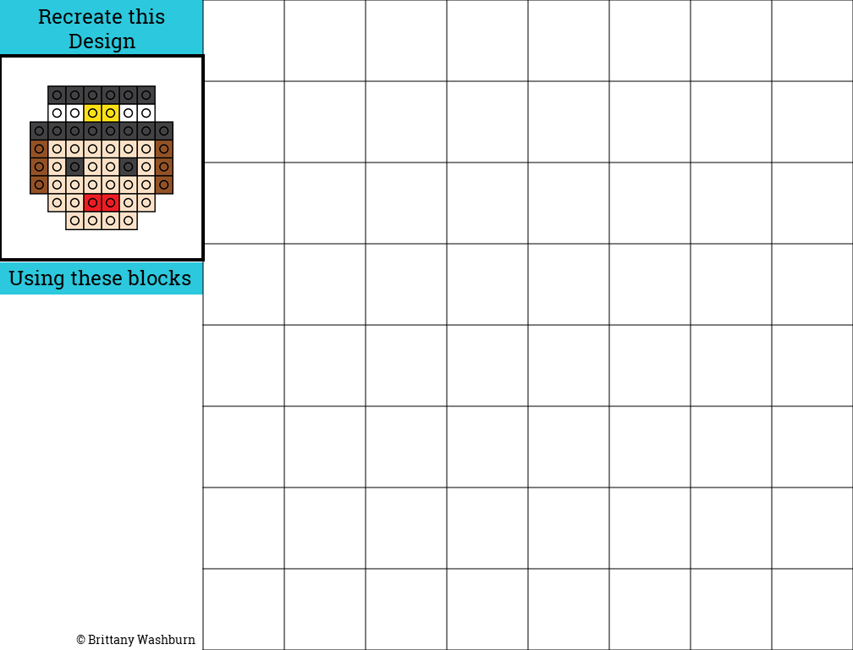

Slide 9
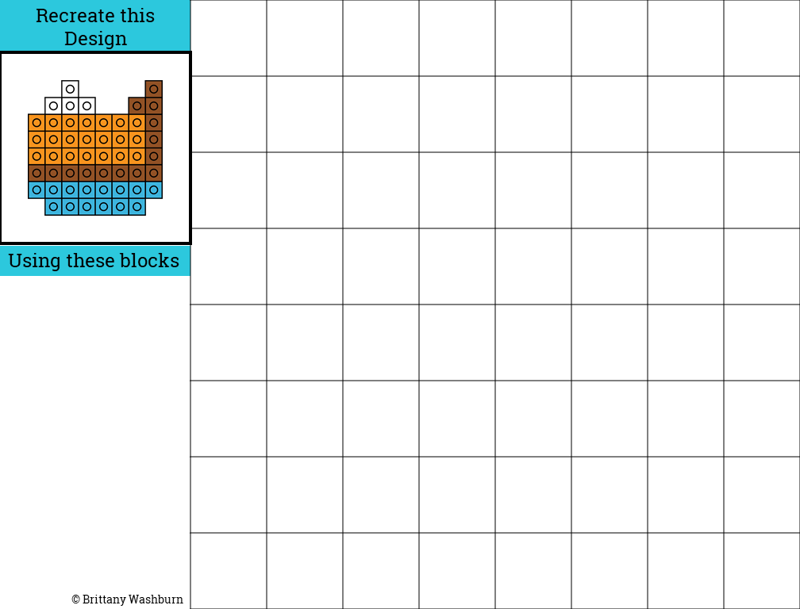

Slide 10
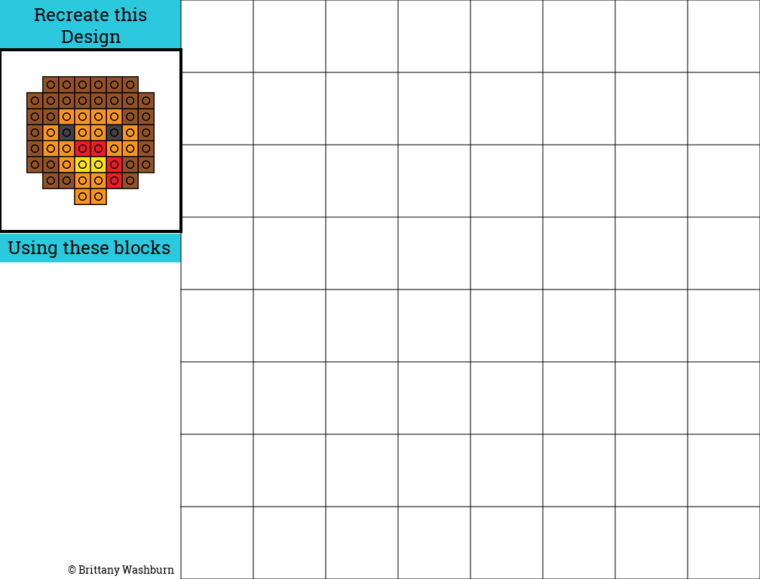

Slide 11
